Slide 1
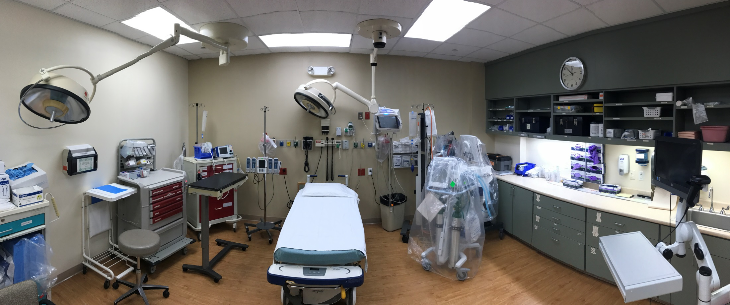
Farm to OR Table: How to Stay Fresh in the Heartlands on Medicine
Carl “Chip” Lange, PA-C

Slide 2
Conflicts of Interest

Slide 3
Power of #FOAMed
Great online resources like Twitter, Reddit, Instagram, YouTube, and Facebook

Slide 4
EMS
Lifestar Podcast, EMS Nation, PHARM, PHEMcast, FlightBridgeED

Slide 5
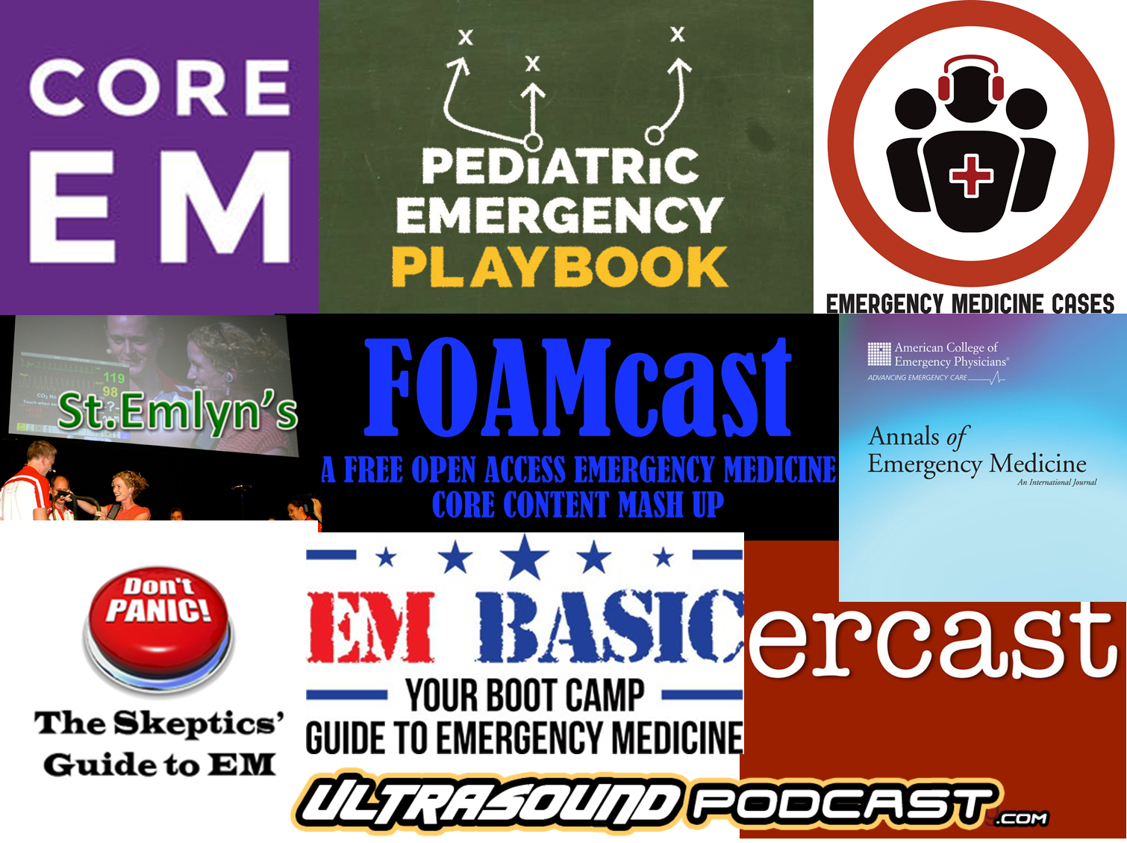
Emergency Medicine
CORE EM, Emergency Medicine Cases, FOAMcast, St. Emlyn’s, Pediatric Emergency Playbook, Annals of Emergency Medicine, ERcast, Skeptic’s Guide to Emergency Medicine, EM Basic, Ultrasound Podcast

Slide 6
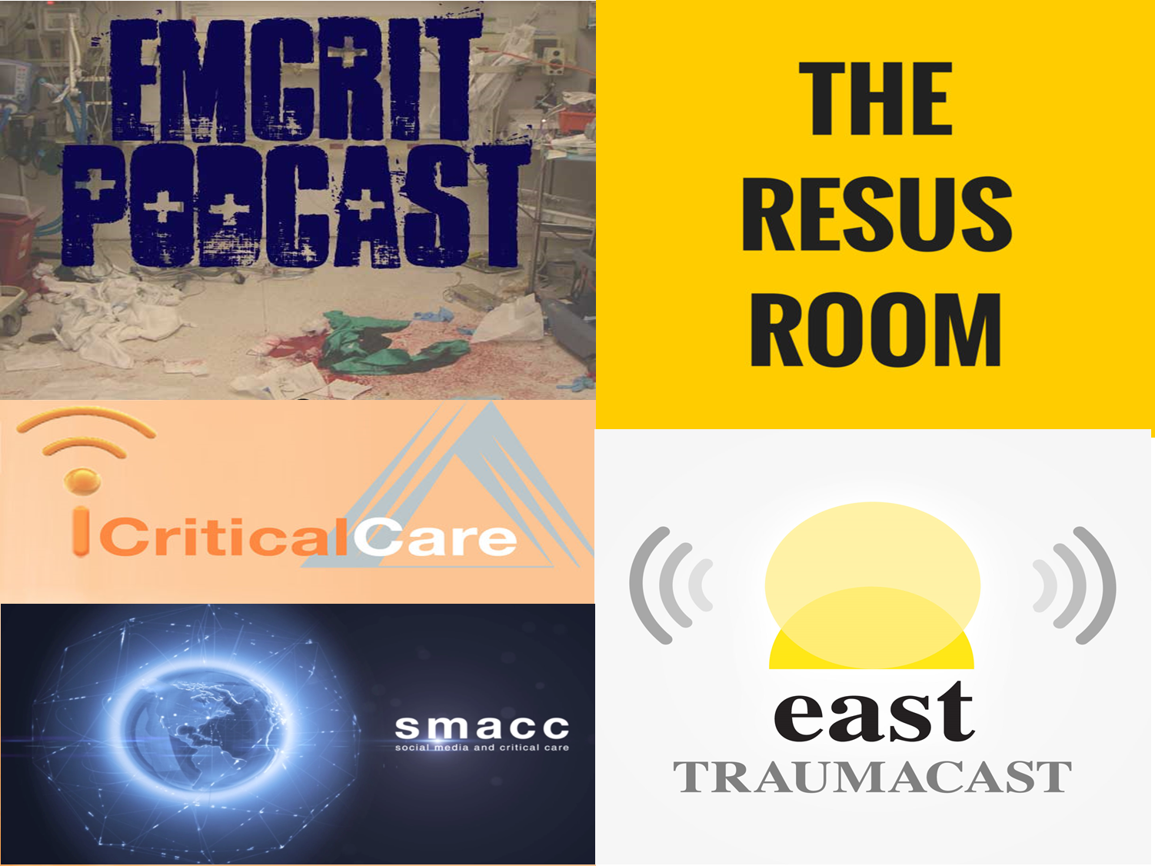
Critical Care
EmCrit, Resus Room, iCritical Care, Traumacast, SMACC

Slide 7
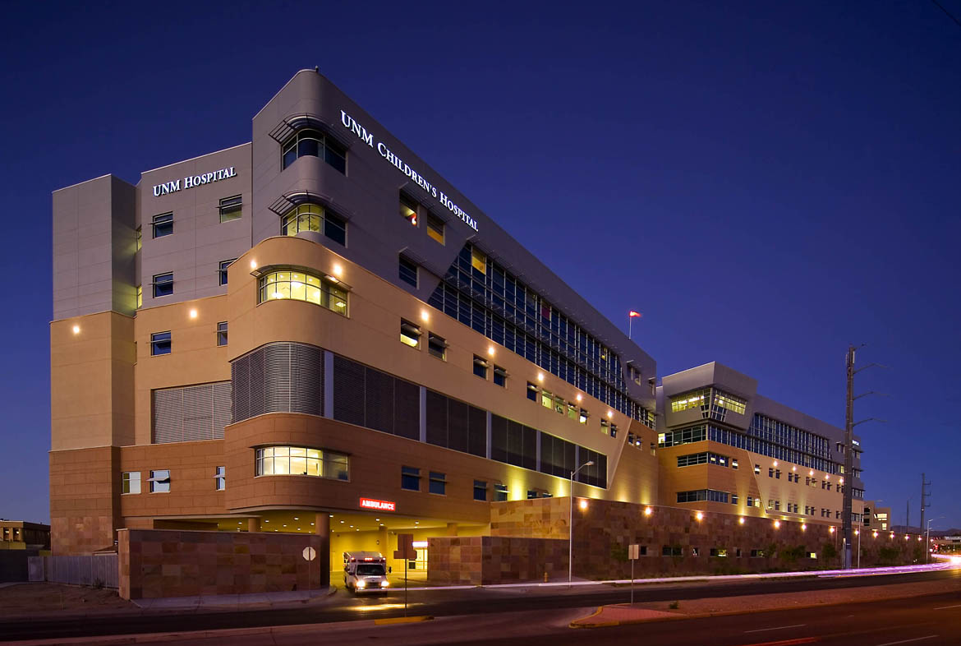
Academia Outreach
Tertiary care and academic centers can help immensely
Need to have outreach at multiple levels

Slide 8
Rural Often Resource Poor
We are often resource poor
Tend not to have most of the specialists (i.e. ophthalmology)
Sometimes we are resource poor as far as equipment or medications (i.e. idarucizumab)

Slide 9
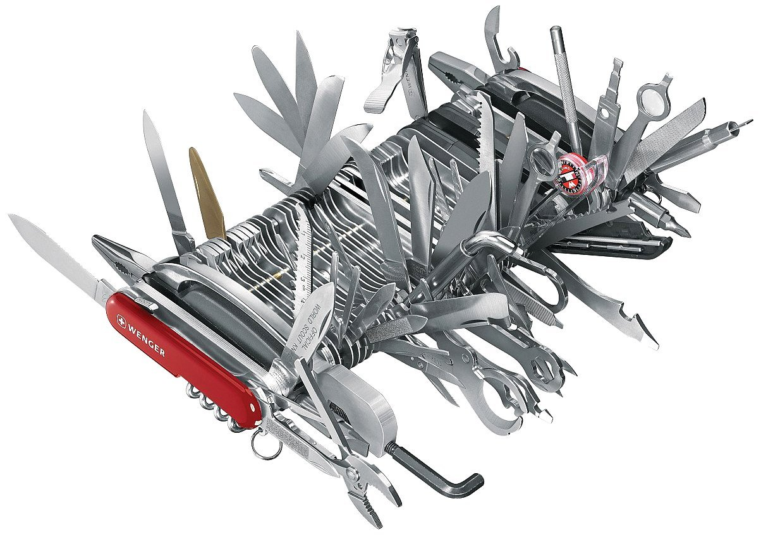
Jack of All Trades
We lack many specialists in the rural setting (such as plastics)
Also have to manage all levels consecutively usually

Slide 10
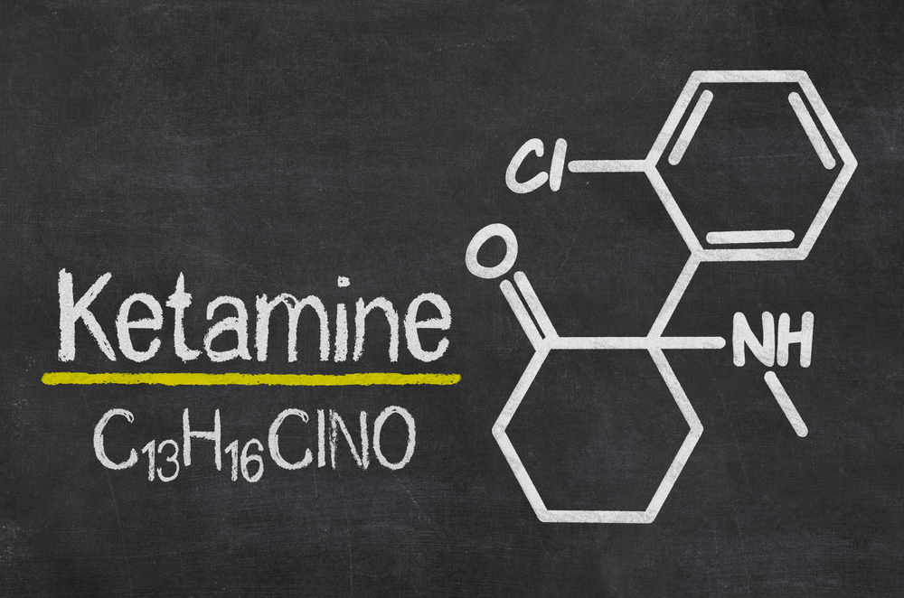
Ketamine
Although a great drug and becoming more frequently used, it is a great example of something slow to change in a rural setting
Dogma tends to live longer in the rural setting

Slide 11
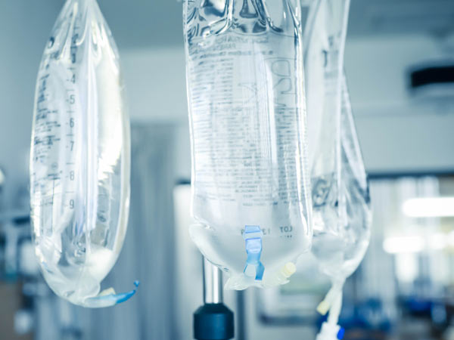
Sepsis Management Constantly Evolving
Aspects like fluid resuscitation and the different versions of sepsis management has significantly changed
At the rate we are changing, hard to stay up to pace with current literature

Slide 12
Tranexamic Acid (TXA)
Powerful and potentially lifesaving, it can be a major delay in the rural setting
We especially need to give these medications early given that patients cannot wait for advanced measures
This is true though for many aspects of trauma

Slide 13
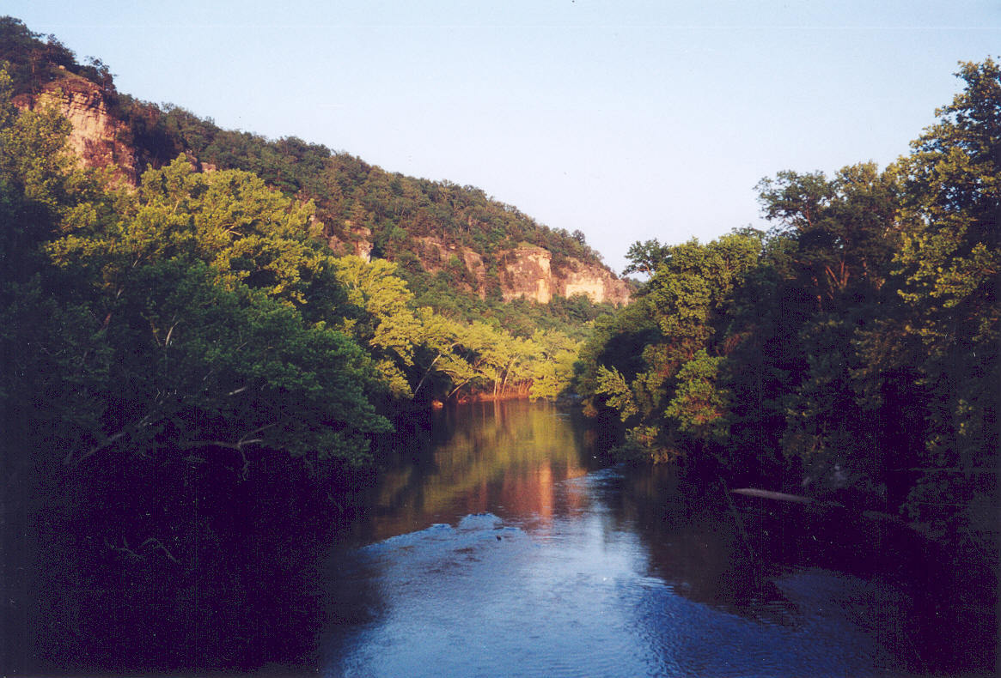
Working Rural
Working in a rural or remote setting is very educational and challenging
Great way to expand scope and abilities, but must balance lower volume and acuity at times
Need to be ready for all cases

Slide 14
Putting it Together
Evidence based medicine is easy to find thanks to #FOAMed
However, we need help from larger centers to get more education
Working rural can make you a better clinician
It takes time for change, especially in a rural setting
We may lack certain resources and will sometimes refer for things that may not seem as severe

